Slide 1
Checkbox and Radio button

Slide 2
Agenda
Checkbox and Radio button
Sample output
Checkbox and Radio button implementation

Slide 3
Checkbox and Radio button
Checkbox
We use checkbox to select more than one option.
We group checkboxes with name attribute.
To display value of option next to checkbox, we use label.
To pass value of the selected checkbox to backend, we use value attribute.
Syntax:
<input type="checkbox" id="" name="" value="same as label">
<label for="">Text here</label>

Slide 4
Checkbox and Radio button
2. Radio button
We use radio button to select only one option from the given options.
We group them using name attribute.
To display value of option next to radio button, we use label.
To send the value selected to backend, we use value attribute where we give label data.
Syntax:
<input type="radio" id="" name="" value="same as label">
<label for="">Text here</label>

Slide 5
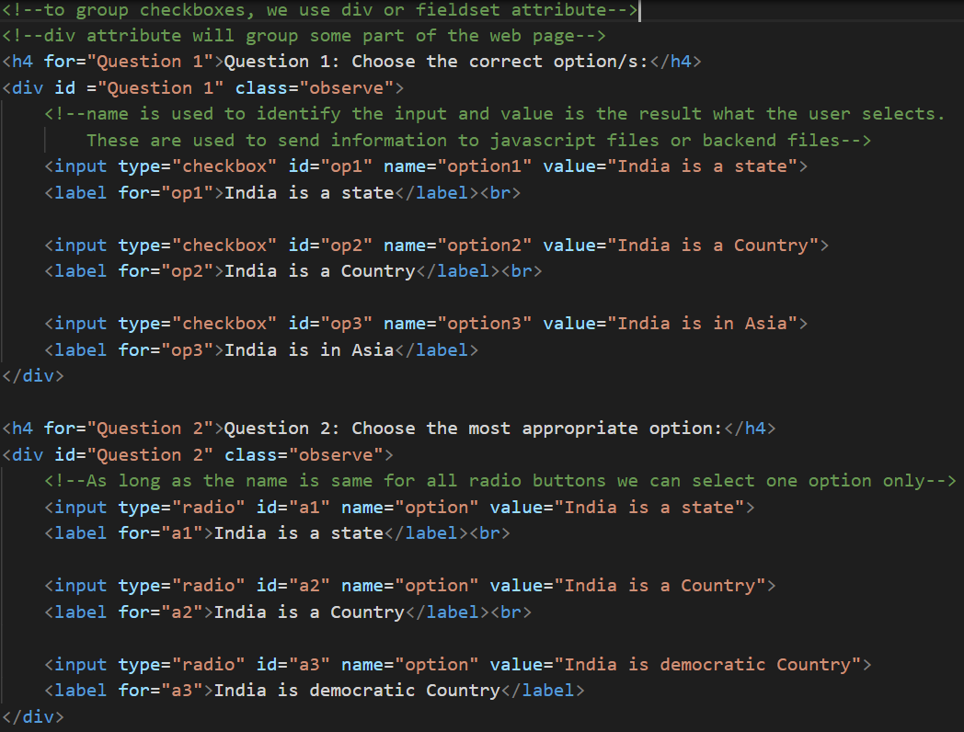
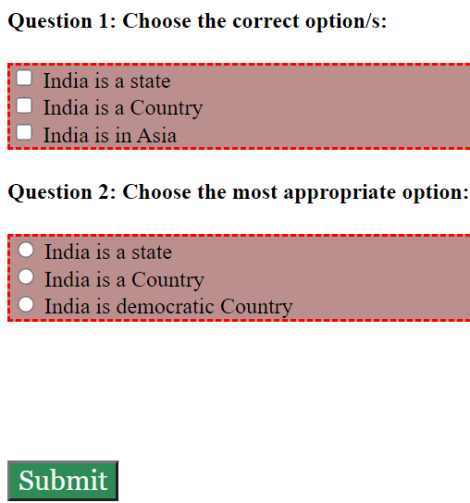
Sample output

Slide 6
Checkbox and Radio button implementation
Let’s see implementation of Checkbox and Radio button.

Slide 7
Summary
Checkbox is used to select one or more than one option whereas radio button is used to select only one option.
We have seen the implementation of the same.
DO NOT WRITE ANYTHING
HERE. LEAVE THIS SPACE FOR
WEBCAM

Slide 8
Thank You
Proprietary content. ©Great Learning. All Rights Reserved. Unauthorized use or distribution prohibited

